Slide 1
Cooperation in rural areas
Civitas Foundation (Ro)
October, 2019

Slide 2
Focus
Central focus of the survey was to determine the factors that foster or discourage socioeconomic cooperation in rural areas.
The analysis is based on 66 responses received from 16 countries, yet with a highest weight from those engaged in cooperative activities in Romania (62%).
The survey questionnaire was based on the following four parts:
General information;
Economic conditions for local cooperation;
Social and organizational conditions for local cooperation;
Main constraints and individual motivation to develop cooperative behavior

Slide 3
Context – Profile of respondents

Slide 4
Context – Profile of respondents

Slide 5
Context – Profile of respondents

Slide 6
Context – Profile of respondents

Slide 7
Context of cooparation

Slide 8
Context of cooparation

Slide 9
Context of cooparation

Slide 10
ECONOMIC CONDITIONS FOR LOCAL COOPERATION

Slide 11
Table 1. How important are for you the following factors in joining or creating a partnership?
Factors | No. of reporting | Unimportant | Neutral | Important | Very important | Totally important
The manufacturing and use of local products and services | 66 | 2% | 8% | 17% | 30% | 44%
The creation of diverse employment possibilities in rural areas | 66 | 0% | 11% | 14% | 30% | 45%
The access to local knowledge and expertise | 65 | 0% | 2% | 11% | 45% | 43%
The optimization of costs | 64 | 3% | 5% | 22% | 38% | 33%
The access to public services (electricity, internet, water) | 64 | 0% | 8% | 13% | 33% | 47%
The distribution of products and services across a wider area | 64 | 0% | 8% | 16% | 28% | 48%
Easier access to financial resources | 65 | 0% | 6% | 8% | 29% | 57%

Slide 12
ECONOMIC CONDITIONS FOR LOCAL COOPERATION

Slide 13
ECONOMIC CONDITIONS FOR LOCAL COOPERATION

Slide 14
Table 3. How important are for you the following factors in joining or creating a partnership?
Factors | No. of reporting | Unimportant | Slightly important | Neutral | Important | Very important
More frequent communication with other partners | 66 | 0% | 2% | 0% | 44% | 55%
To have greater influence on local decisions | 65 | 0% | 2% | 15% | 49% | 34%
To get a better picture about the various actors' behavior and trustworthiness | 65 | 0% | 3% | 8% | 62% | 28%
To gain more information about the local environment | 66 | 0% | 2% | 9% | 48% | 41%
To gain access to a system where mutual respect is essential | 65 | 0% | 5% | 15% | 46% | 34%
To participate in actions which strengthen personal and professional connections at local and regional level | 66 | 0% | 5% | 2% | 50% | 44%
To reduce the level of stress and of the workload | 66 | 2% | 17% | 27% | 35% | 17%
To promote local culture and traditions | 65 | 2% | 5% | 8% | 45% | 38%
To increase the level of certainty through affiliation | 65 | 2% | 5% | 17% | 49% | 23%
To increase reputation by working together with better-known partners | 66 | 0% | 0% | 14% | 52% | 32%

Slide 15
SOCIAL AND ORGANIZATIONAL CONDITIONS FOR LOCAL COOPERATION

Slide 16
Table 4. How would you rate the level of the following factors within the partnership you are part of? (1 – not important, 5 – very importnat)
Factors | No. of reporting | 1 | 2 | 3 | 4 | 5
The level of ownership | 65 | 12% | 12% | 31% | 28% | 17%
The level of trust | 65 | 0% | 5% | 23% | 42% | 31%
[The level of communication | 64 | 0% | 6% | 17% | 47% | 30%
The level of interaction | 65 | 0% | 6% | 15% | 57% | 22%
Decisions moved by relationships | 64 | 8% | 6% | 31% | 36% | 19%
The level of management capabilities | 65 | 3% | 5% | 14% | 43% | 35%
The level of administrative capabilities | 65 | 2% | 5% | 23% | 51% | 20%
The level of members' involvement | 65 | 3% | 8% | 23% | 34% | 32%
The level of community's involvement in decision making | 64 | 6% | 14% | 25% | 34% | 20%
The existence of procedural rules | 65 | 3% | 12% | 25% | 37% | 23%
The consideration of your ideas and opinion | 64 | 3% | 5% | 20% | 52% | 20%

Slide 17
SOCIAL AND ORGANIZATIONAL CONDITIONS FOR LOCAL COOPERATION (2)

Slide 18
Table 5. How do you evaluate the impact of the partnership (in which you are active) on the following aspects?
Factors | No.of reporting | None | Weak | Moderate | High | Very high
Improvement of communication with other partners | 65 | 0% | 8% | 14% | 65% | 14%
The involvement of members | 65 | 0% | 6% | 23% | 60% | 11%
The understanding about the trustworthiness of the other partners | 64 | 0% | 8% | 27% | 50% | 16%
Increased level of trust between partners | 64 | 0% | 5% | 20% | 53% | 22%
Increase of mutual respect between partners | 65 | 0% | 2% | 15% | 60% | 23%
Strengthened connections and relationships | 64 | 0% | 2% | 20% | 58% | 20%
Decrease of the level of stress and workload | 65 | 2% | 28% | 45% | 22% | 3%
Better promotion of local culture and traditions | 65 | 5% | 6% | 26% | 45% | 18%
Increased management and coordination capabilities of partners | 65 | 0% | 9% | 15% | 60% | 15%
Better image creation | 65 | 0% | 2% | 22% | 57% | 20%

Slide 19
SOCIAL AND ORGANIZATIONAL CONDITIONS FOR LOCAL COOPERATION (4)

Slide 20
MAIN CONSTRAINTS AND INDIVIDUAL MOTIVATION TO DEVELOP COOPERATIVE BEHAVIOR
Table 6. Assess on a scale from 1 to 5 the level of the following barriers to create a healthy and effective cooperation
Factors | No.of reporting | 1 | 2 | 3 | 4 | 5
Lack of management efficiency | 66 | 0% | 12% | 18% | 38% | 32%
Uneducated and unskilled members | 65 | 6% | 8% | 31% | 32% | 23%
Lack of mutual trust | 66 | 3% | 8% | 21% | 30% | 38%
Lack of cooperative mindset | 66 | 5% | 9% | 15% | 36% | 35%
Lack of communication | 65 | 0% | 11% | 17% | 37% | 35%
Strong influence of political orientation | 65 | 9% | 20% | 17% | 32% | 22%
High level of nepotism and corruption | 66 | 14% | 21% | 20% | 15% | 30%
Lack of strategic planning | 66 | 3% | 8% | 15% | 38% | 36%
Lack of financial resources of members | 64 | 3% | 5% | 17% | 39% | 36%
Lack of clear instructions in bureaucratic processes | 66 | 2% | 11% | 26% | 38% | 24%
Unclear understanding of duties and responsibilities | 66 | 2% | 14% | 18% | 36% | 30%
Favoritism on granting loans/grants | 64 | 5% | 20% | 17% | 28% | 30%

Slide 21
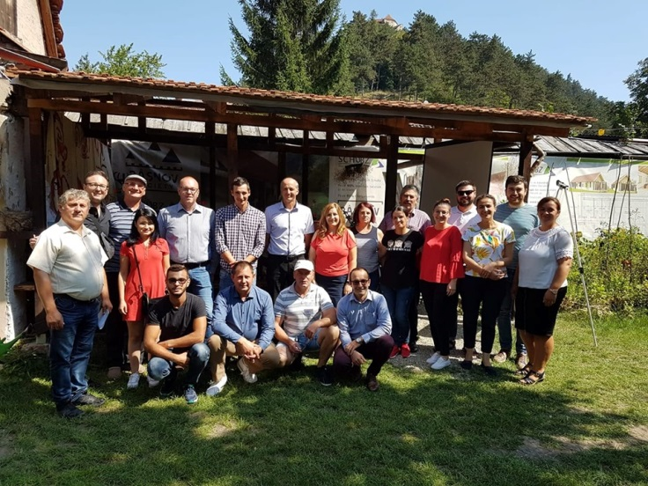
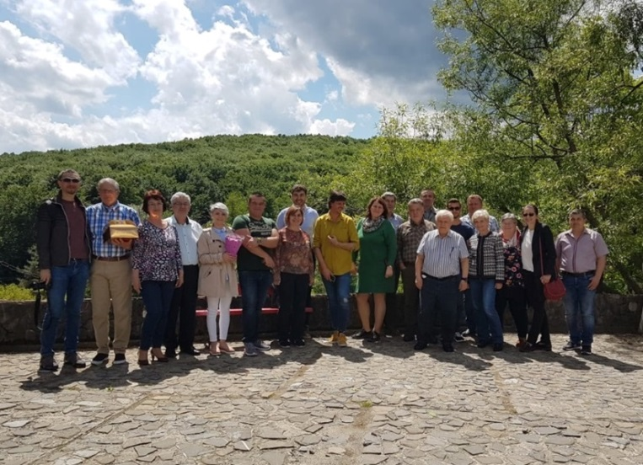
CoopNet – A cooperation for agricultural Cooperatives facilitators - case study
Developed in order to support the specific partnerships that are implementing the LEADER associativity projects (specific goal, increasing capacity for the partenerships developed on the art 35 of Reg(UE). 1305)
81 members: 49 LAGs, 16 coops, 10 private entities (NGO included) , 6 relevant public institutions.
Services: training, network meetings, representation.

Slide 22
Conclusions
the level of local economic cooperation is influenced by economic, social and organizational factors that foster or discourage socioeconomic cooperation in rural areas;
according to the analysis the most popular entities or possibilities that enable cooperative actions are partnerships projects and the Local Action Groups;
from an economic perspective the most significant factors that motivate various actors to join common initiatives are the easier access to financial resources (when making part of a partnership) and the extended possibilities to distribute the created products or services, consequently to create a larger customer base;
from an infrastructural perspective the access to public services such as electricity, water, internet was pointed as being imperative necessity to successful operation of joint ventures;
next to this, from a human resource perspective the access to local knowledge was also considered important motivational aspect. The conducive factors that drive various stakeholders to get involved in collaborative action are the creation of diverse employment possibilities and the creation/use of local products/services;
regarding the attitude towards competitors, there was a large compliance with the benefit of sustaining collaborative relationship with these, as there was a common agreement on the statement

Slide 23
Conclusions (2)
that competition instigates earlier achievement. Nevertheless, there was a mutual and wide incertitude regarding the threatening nature of competitors;
when considering to take up innovative approaches the greatest partners to appeal to were considered to be the Local Action Groups, universities and NGOs. The latter ones were also seen as helpful sources of information together with the local public institutions yet, the internet was pointed to be the main source of information for everyday professional decisions;
the main sources of funding for common initiatives are the non-refundable funds from EU, own funds and non-refundable funds from other sources such as private foundations for example;
the greatest economic contribution of joint initiatives on an entity was the possibility to get better access to projects/investments and the support in diversifying the business activities on the local market;
the greatest economic contribution of a partnership to the rural areas is through offering increased access to education and training possibilities, increasing the quality of local products and services, offering wider employment opportunities and also bringing more financial resources;

Slide 24
Conclusions (3)
in general, as social and organizational drivers to collaborative action are considered to be: the possibility for more frequent communication with the partner organizations and the chance to strengthen personal and professional connections not only at local but also regional level;
by joining a partnership, there is greater opportunity to learn about the partner’s behavior in certain situations, trustworthiness and also to gain more information about the local environment through the joint actions. On the other hand, the reduction of stress and workload does not seem to be a strong motivational factor to join a partnership;
when creating a partnership in rural areas the greatest demographic challenges are the lack of skilled human workforce and the ageing population;
from an operational perspective, the level of management capabilities, of interaction, communication but also the level of trust and consideration of ideas are seen to be good or very good. Greater improvements are required in terms of ownership and the involvement of the community in the decision-making process. Further on, relationships are also believed to have a prevalent influence when it comes to decisions;

Slide 25
Conclusions (4)
Local Action Groups and NGOs are considered to be the most significant actors in the creation of partnerships;
from a social and operational perspective, joining common initiatives increases the level of mutual respect between partners, improves communication between the associates and strengthens connections and relationships. Partnerships also support a better image creation and in most cases are seen to contribute to a better promotion of the local culture, yet not sufficiently;
most effective elements that facilitate a better functioning of partnerships are the organization of events and availability of information on legal framework;
in general, the available ventures for conferences/meetings are considered to be of high quality nevertheless, business centres are believed to demand more improvements;
in general, the main barriers in the creation of healthy and effective cooperation are considered to be the following: lack of financial resources, lack of strategic planning, lack of communication and lack of cooperative mindset; the greatest distribution of opinions was related to the level of nepotism and corruption and the influence of political orientation;
the survey offers evidence on the fact that cooperation works quite well within NGOs and LAGs and there are good opportunities in the local economies of rural areas for interaction and for joint initiatives;

