Slide 1
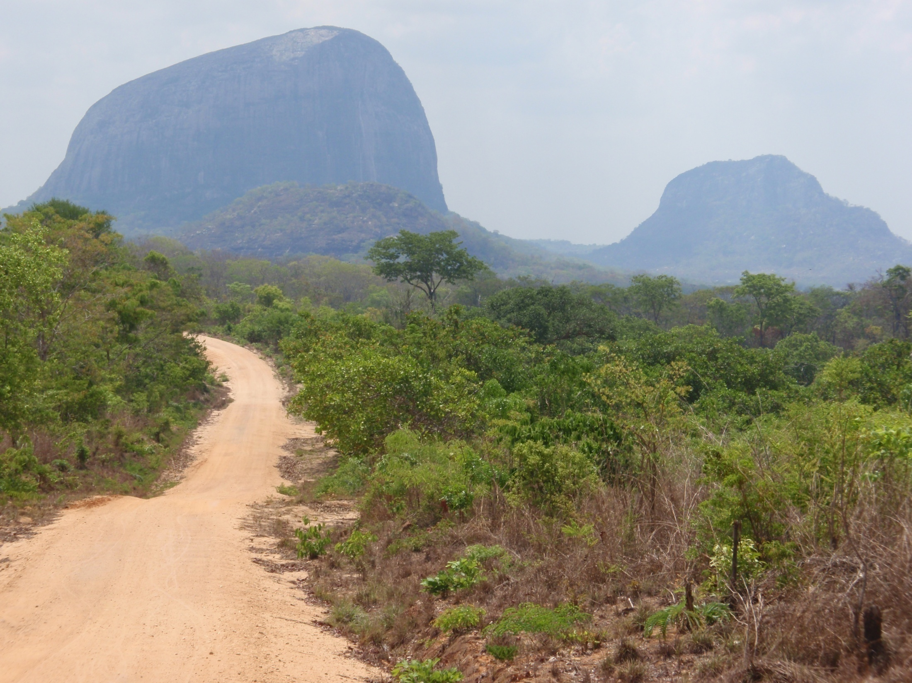
LEADER in Mozambique
Petri Rinne, ELARD

Slide 2
LEADER road to Africa
OECD regional policy analysis on Finland in 2005 → LEADER identified as one of the best practices → has the method ever been applied outside of the EU?
Inter-Ministry Finnish Rural Policy Committee launches a comparison study between Finland, Ireland and the Czech Republic on LEADER implementation to draw conclusions for geographical dissemination
Finnish Minister of Development Affairs Ms Paula Lehtomäki’s initiative to search Finnish/ European value-added to Finnish Government’s development aid programmes → cooperation with Mozambique (the biggest target country of Finnish development aid) and the Finnish Embassy in Maputo begins in 2006

Slide 3
Conditions for Dissemination
Sub-regional level commitment and capacity to design a Local Development Strategy (political / higher level institutional support also helps to achieve sustainabilty – e.g. in Mozambique the Government supports the decentralisation process)
Creation of a Local Action Group (LAG) that is running the development process in a public-private-civil sector partnership principle (in Mozambique the local level ”Conselho consultivos” were already running in 2006)
Funding for the Local Development Strategy implementation through project selection (including LAG staff recruitment, office running costs, capacity building of LAG members and applicants, project monitoring etc)

Slide 4
Delivery
Finnish Ministry of Foreign Affairs
(donor)
OECD & Embassy expertise
Zambezia Province
(main partner)
Joutsenten Reitti LAG (pr. owner)
Gile District
(funds channel)
GAL Alto Ligonha
(conselho consultivo)
Berlin Humboldt & Eduardo Mondlane Universities (evaluator)
Micro-projects

Slide 5
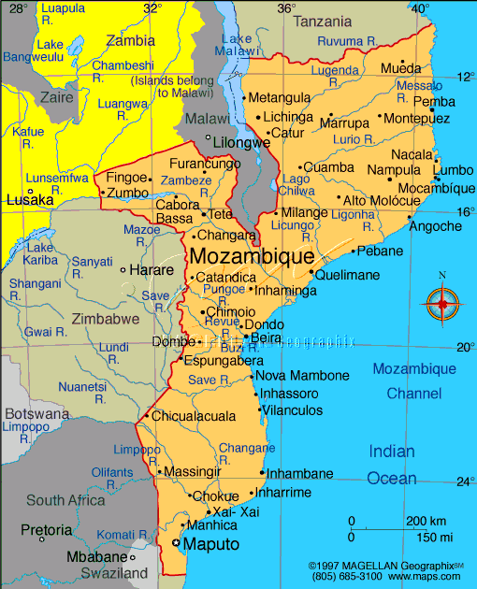
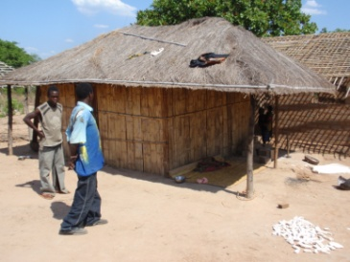
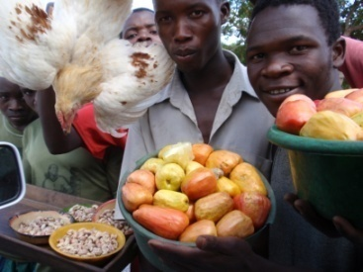
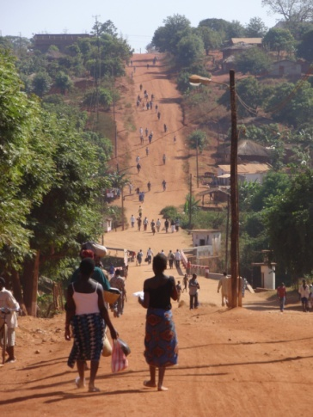
Adaptability in a very new and different environment?
Case Mozambique, Alto Ligonha
170 000 inhabitants (38/km²)
half less than 15 years old
life expectancy 35 years
2007: Lecturing & Province agreement
2008: Local strategy design
1) agricultural cooperatives
2) local trade structures
3) community forestry
2009-13: 35 LEADER projects selected
worth of 40 000 €
2011: Mid-term evaluation: >500 new jobs created, new businesses etc
2014-15: Dissemination to three new Districts in Zambesia, Sofala & Capo Delgado

Slide 6
The lessons learnt
LEADER can adapt anywhere!
In Africa it’s more about giving access, in Europe about mobilising people
Small funds and grants don’t attract the corrupted people
Politicians need concrete development tools to be handed over to people
Involve everyone in the strategy building process – use the local media
Capacity building/ training sessions are crucial in the beginning
Teach by example and good practice rather than long lectures
Constant monitoring of the projects in a supportive way pays back
Develop easy-to-use indicators to measure the outcomes and impacts
If something goes wrong, the LAG or Managing Authority must intervene

Slide 7
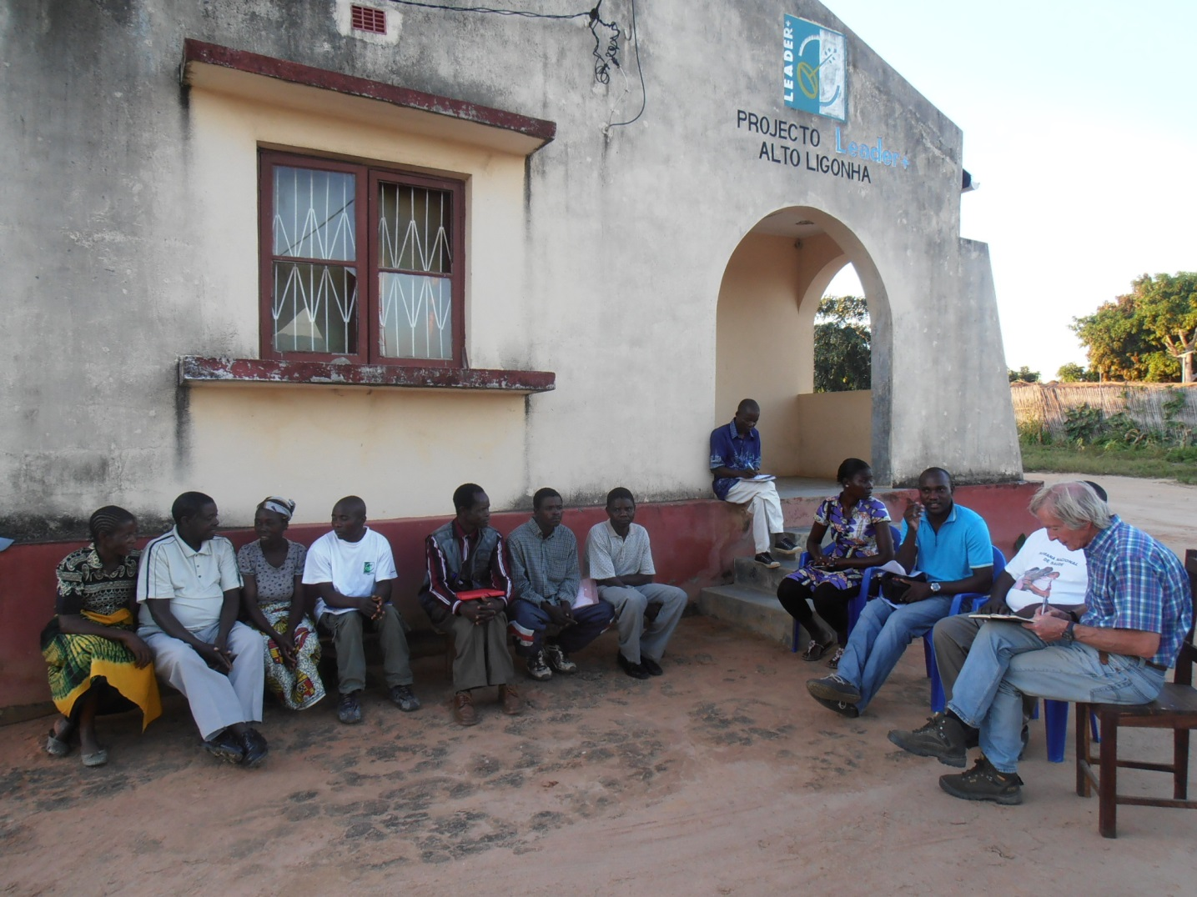

Slide 8
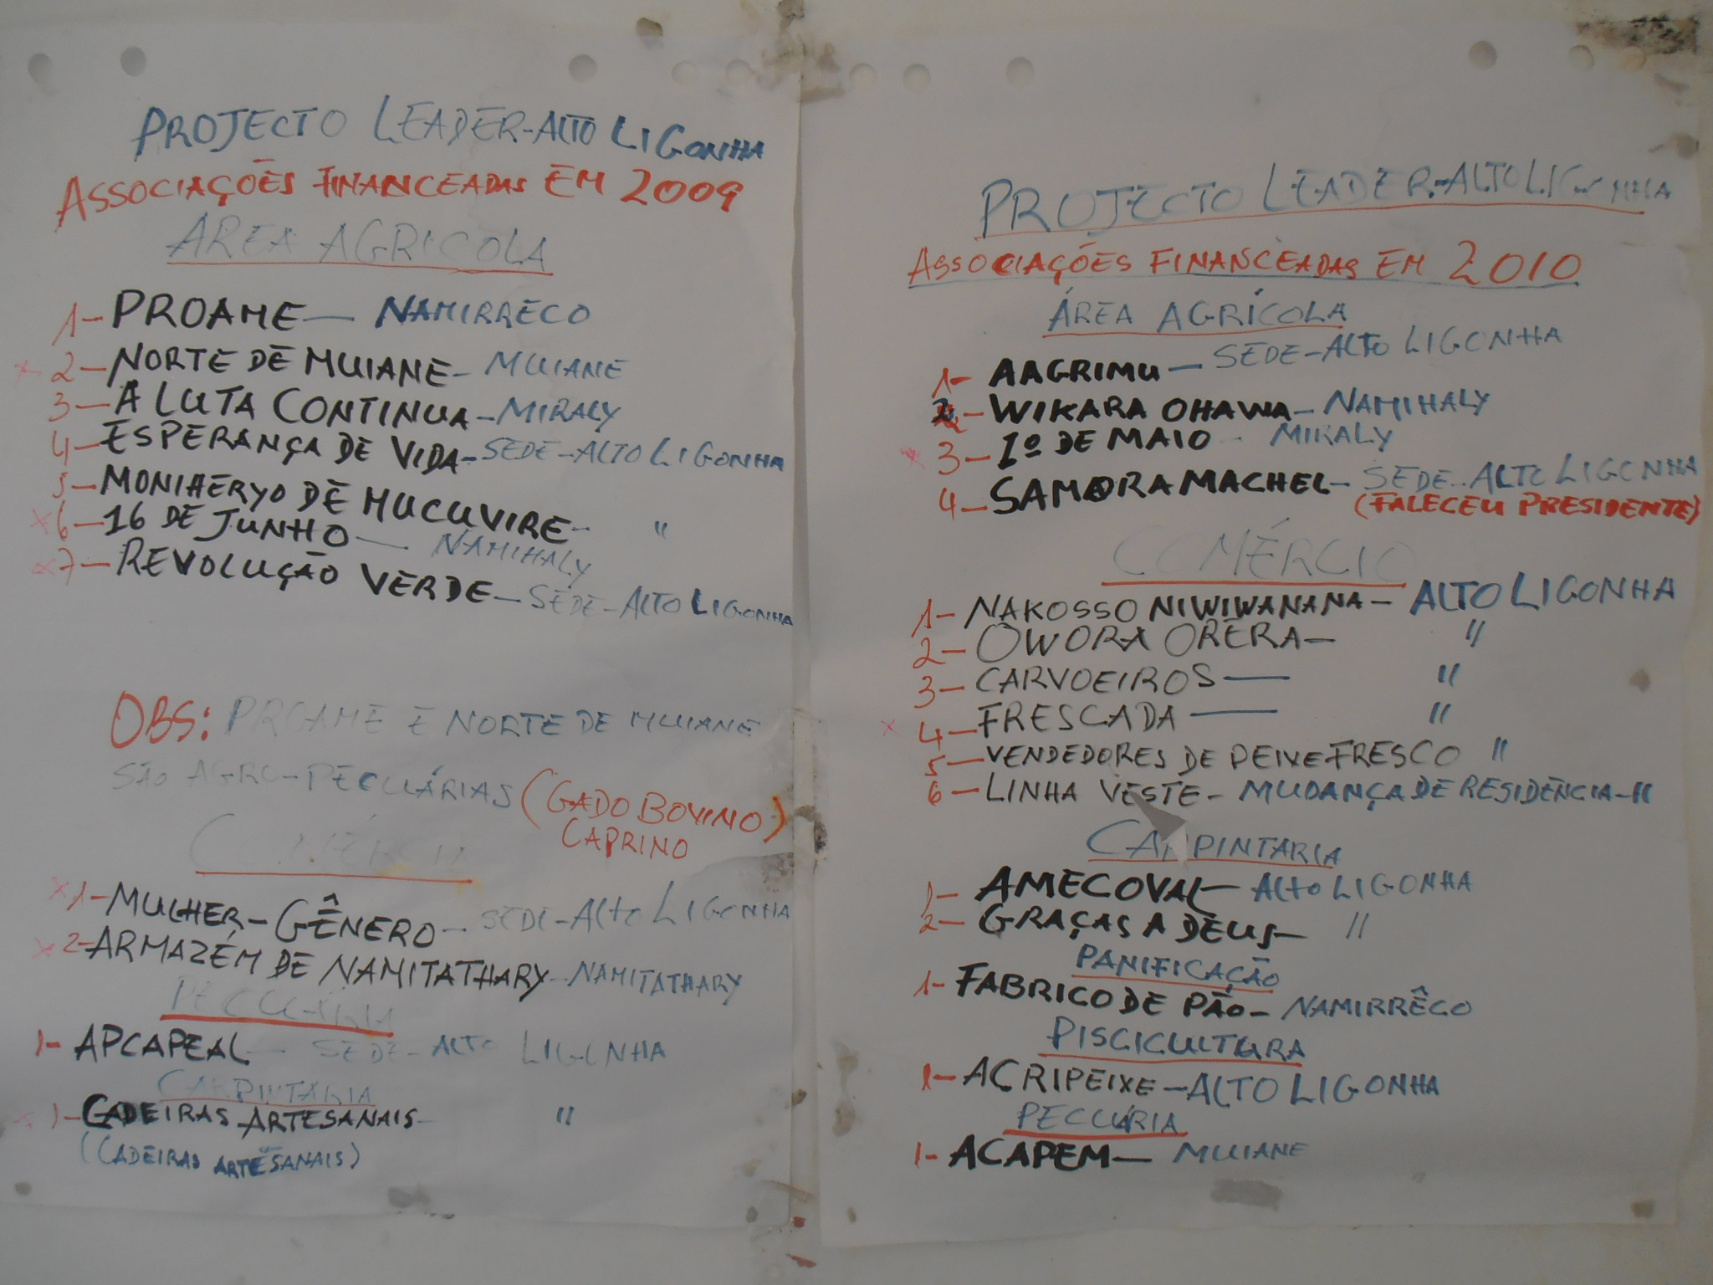

Slide 9
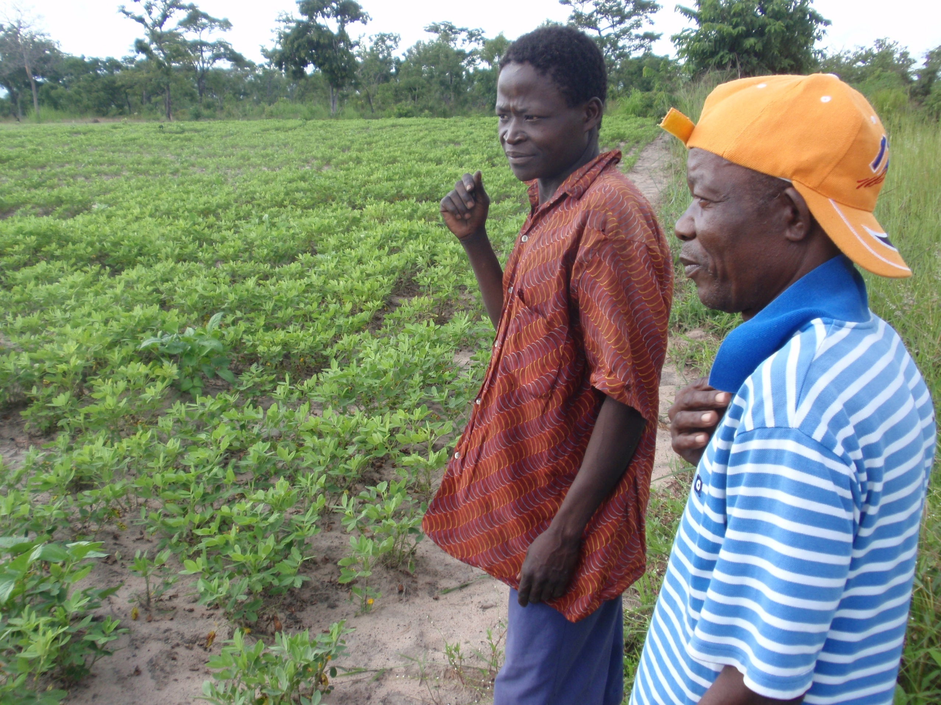

Slide 10
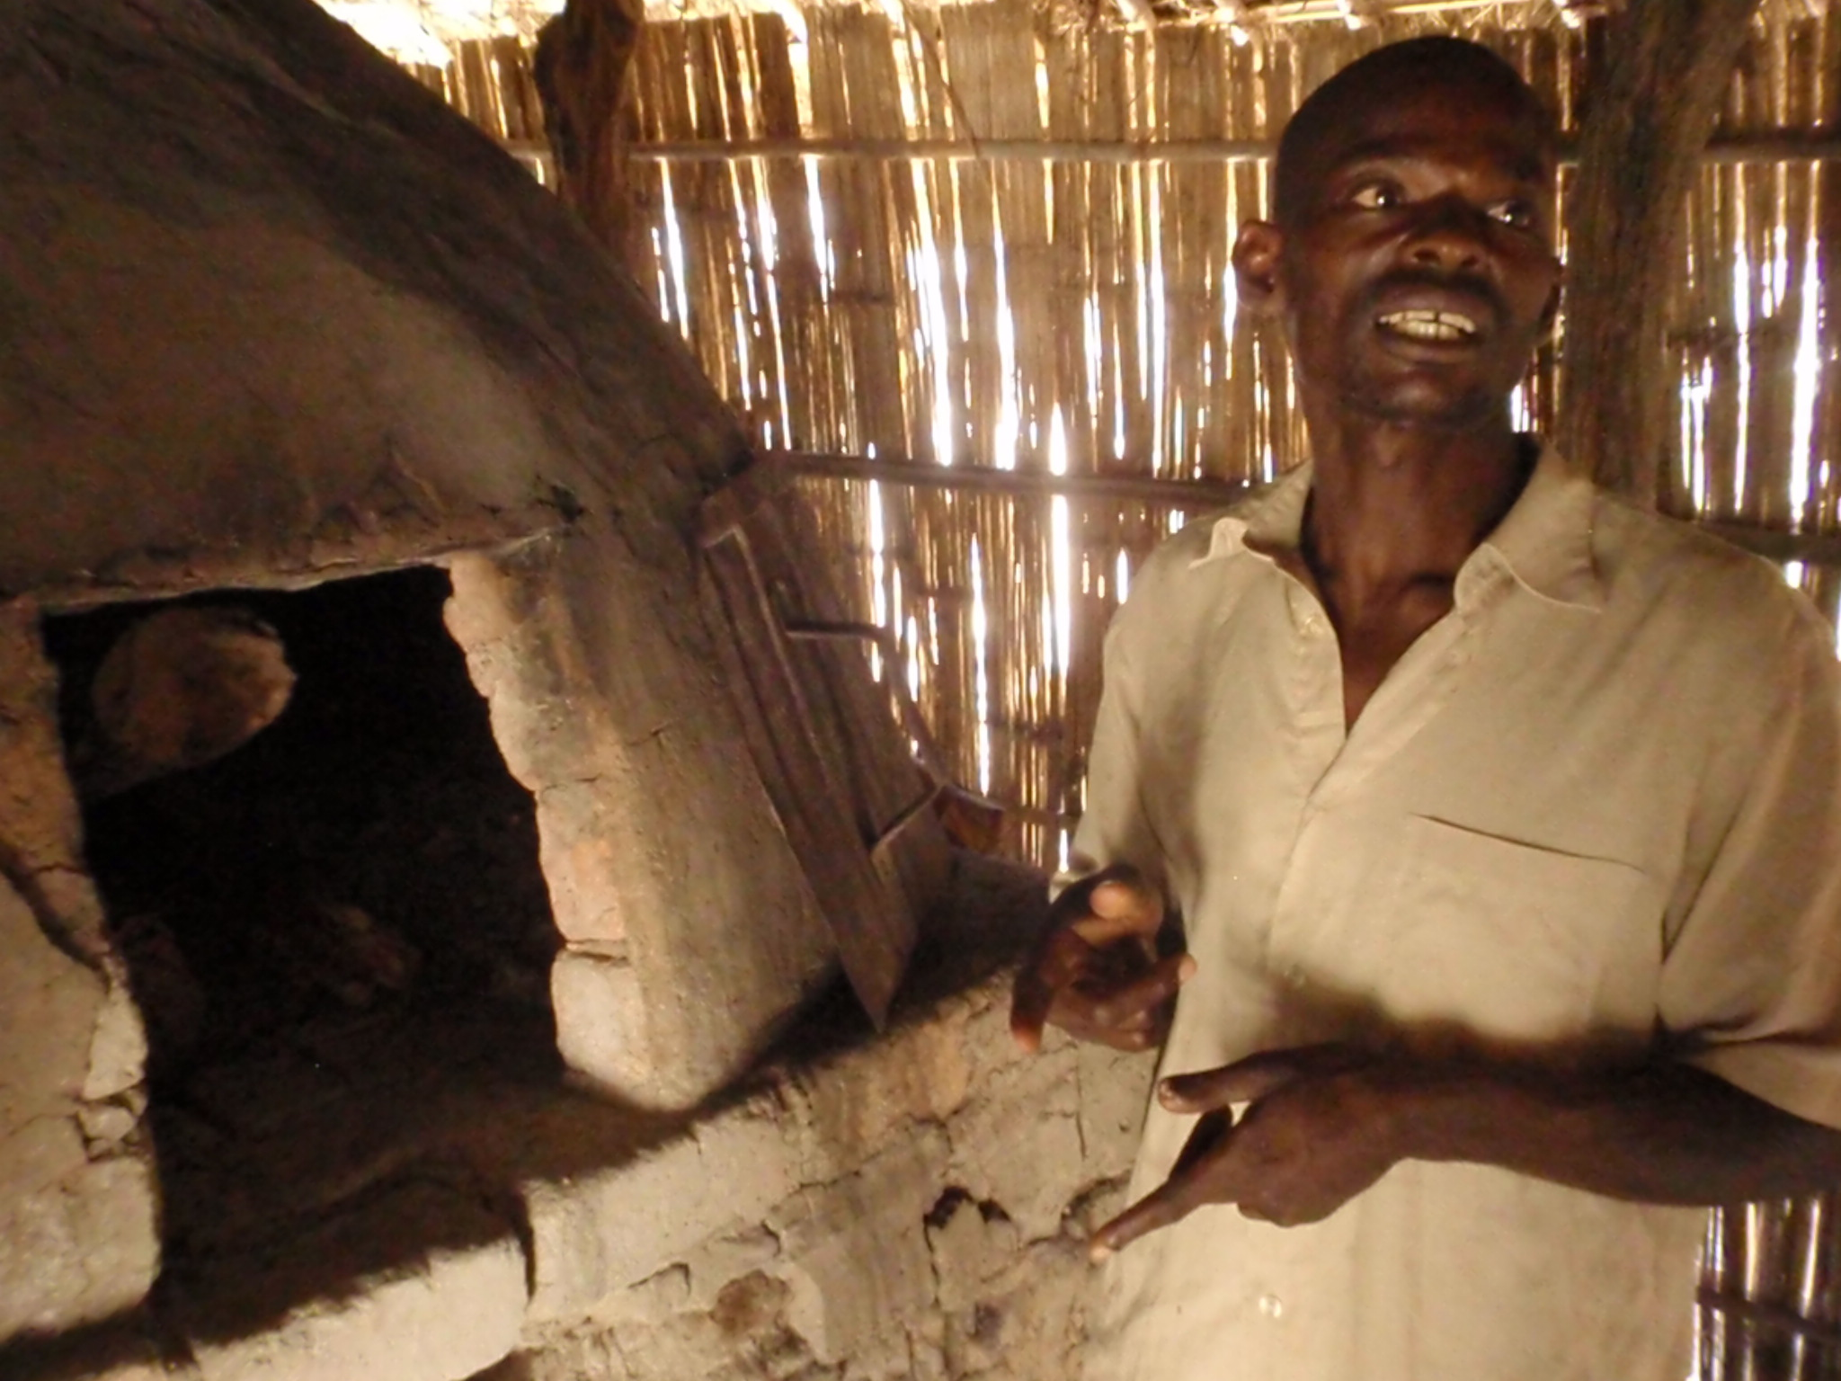

Slide 11
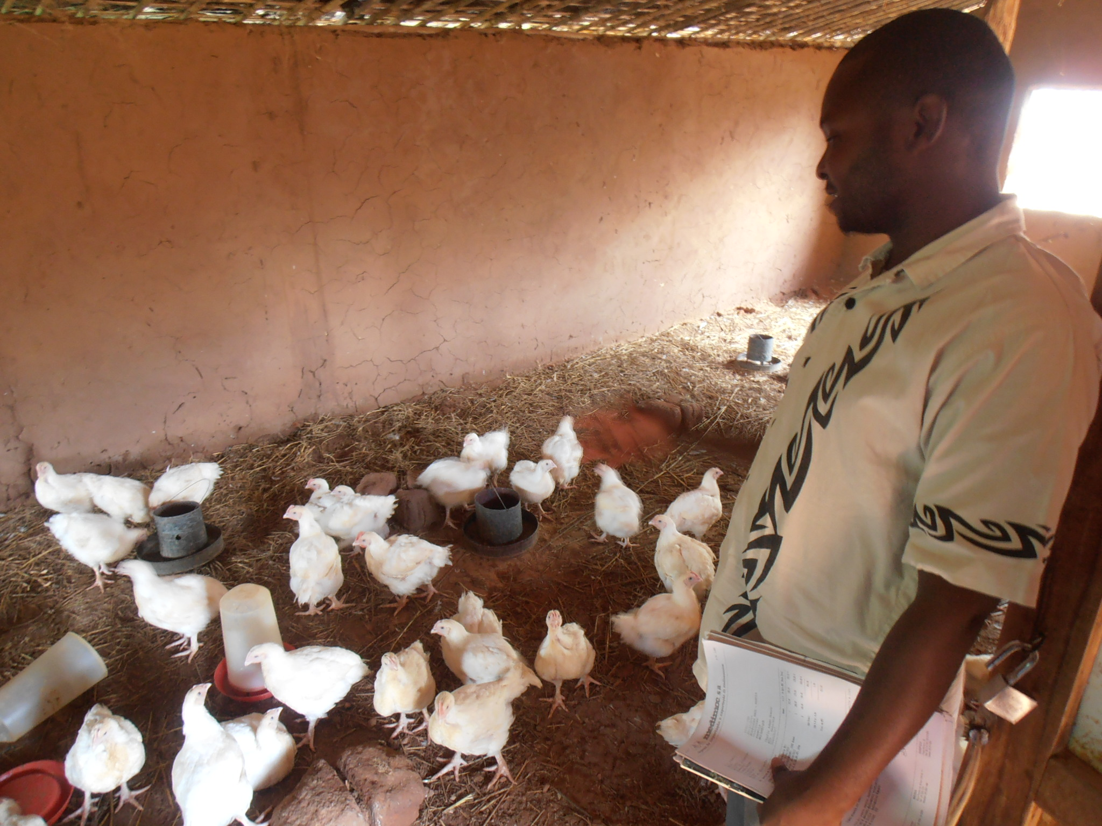

Slide 12
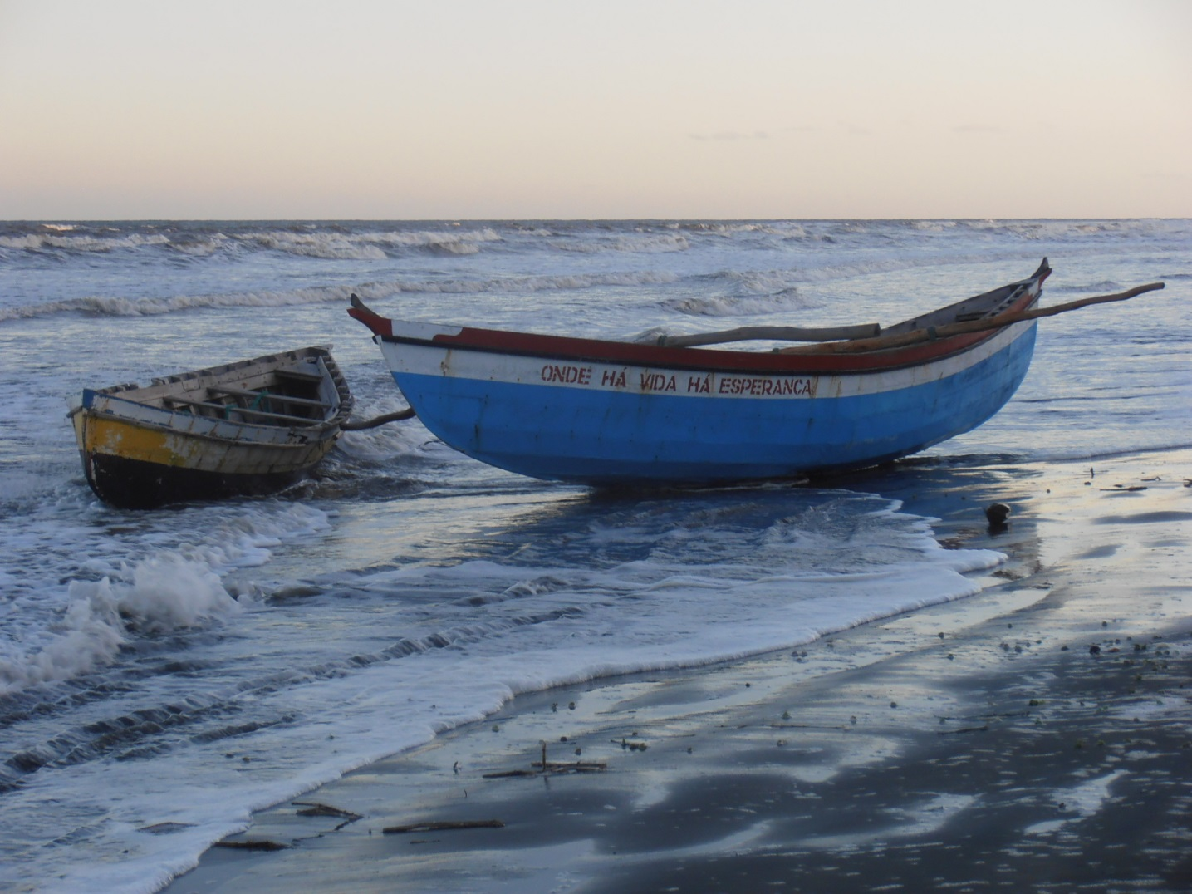

Slide 13
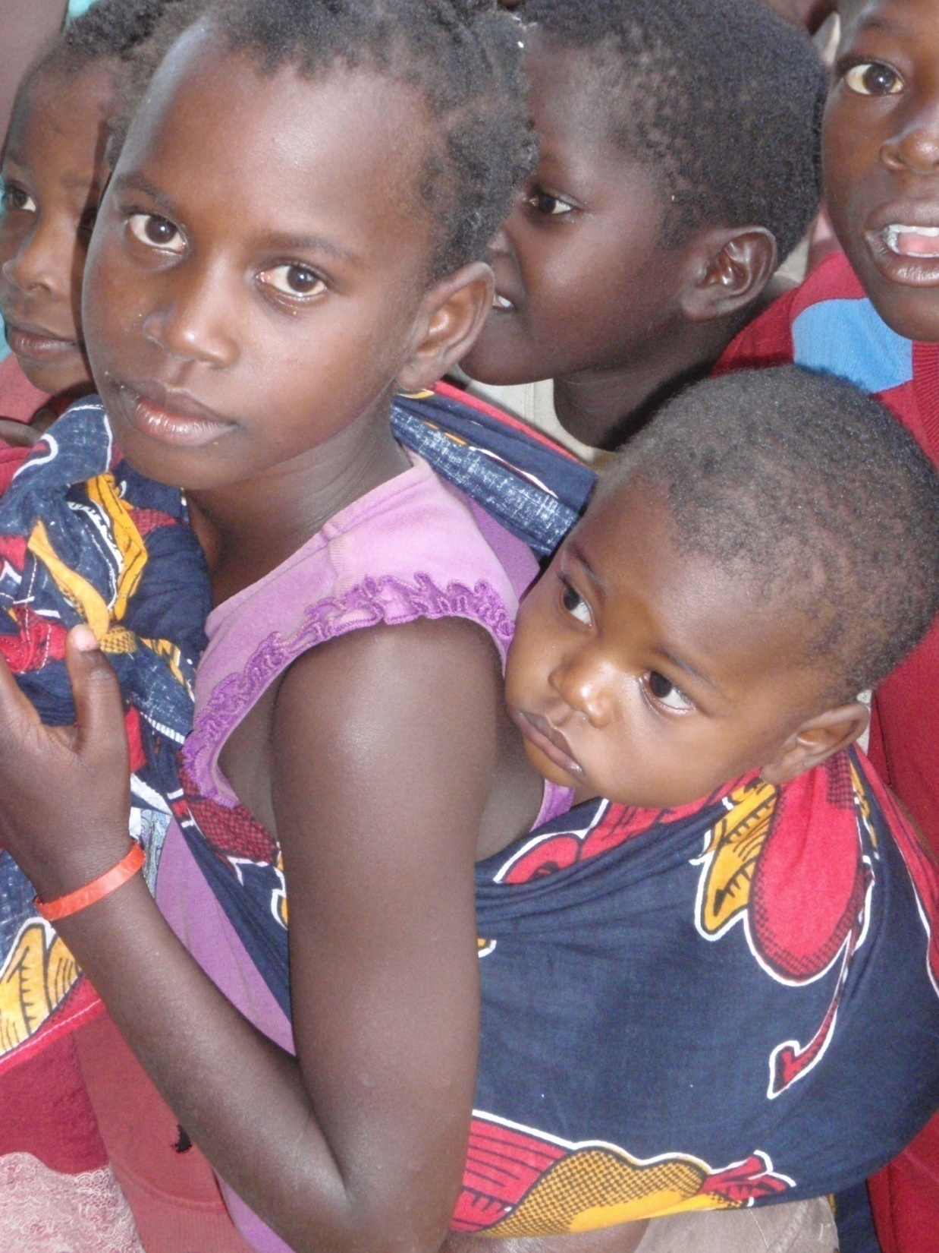
THANKS FOR YOUR ATTENTION!
See more in Google:
A LEADER Dissemination Guide Book
Contact:
Mr Petri Rinne
petri.rinne@elard.eu
www.elard.eu
Tel. +358 40 555 3232

